Slide 1
Audits of Less Complex Entities:
ISA for LCE
Vivian Teh
Peyman Momenan
12 October 2021

Slide 2
Housekeeping
These slides have been prepared using the International Auditing and Assurance Standard Board (IAASB) LCE outreach slides.
We recommend viewing in side by side mode
During the presentation please keep microphones muted and video off
If you have any questions please use the ‘Q&A’ function and we will address it during the Q&A session at the end.
The webinar will be recorded.

Slide 3

What is the Aim?
A Global Solution for Audits of Less Complex Entities

Slide 4
ED-ISA for LCE: Open for Comment
XRB » Assurance Standards » Standards in Development » Open for Comment » IAASB LCE
Published in July 2021
Comments due on 5 November 2021
Explanatory Memorandum
Related Materials

Slide 5
Proportionate to Audits of LCEs
Proportionate to the nature and circumstances of an audit of an LCE
Based on underlying concepts from ISAs adapted as appropriate
Requirements for procedures that are not relevant to an audit of an LCE not included

Slide 6
Basis of Design
Separate, Standalone Standard
Designed to provide Reasonable Assurance
Alternative to using the full set of ISAs
No reference back to the ISAs
ISAs can’t be used to “top-up”
High but not absolute level of assurance
Same level of assurance as an audit under the full set of ISAs

Slide 7

When can it be used?
Specific Prohibitions
Listed entities
Audits of Group Financial Statements
Classes of Entities with Public Interest Characteristics*
Otherwise Prohibited or Restricted by Jurisdiction or the Firm
Qualitative Characteristics of Complexity
Accounting Estimates
Business Activities, Business Model or Industry
Ownership, Oversight or Organisational Structure
IT Environment & Systems
Transactions & Information Processing
*Descriptions of classes may be modified in local jurisdiction

Slide 8
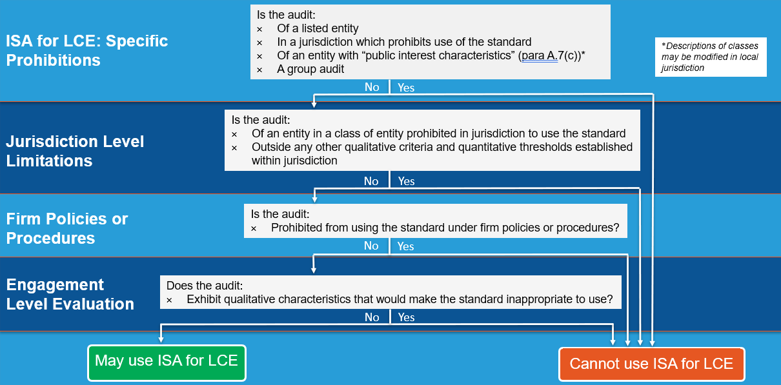
Authority of the Standard

Slide 9
Jurisdictional Responsibilities
Deposits from the public
Provides insurance to the public
Provides post-employment benefits
Collective investment vehicles
Allow or require use of ISA for LCE
Additional quantitative thresholds
Can modify entities with public interest characteristics

Slide 10
Other’s Responsibilities for Using the Standard
Engagement Team
Evaluate whether use is appropriate for a particular engagement
Evaluate against qualitative characteristics
Evaluate at client acceptance / continuance & throughout audit
Stand back requirement
Firms
Establishing policies or procedures for permitted use
Cannot conflict or override prohibitions in the standard or jurisdictional determinations

Slide 11
ED-ISA for LCE
Risk based approach
Principle based
Focused on expected output
Based on underlying concepts from ISAs
Understandable, Clear & Concise
Essential Explanatory Material
Design Principles

Slide 12
The Flow of the Standard
Flow of Audit
Part 4:
Acceptance or Continuance of an Audit Engagement and Initial Audit Engagements
Part 5:
Planning
Part 6:
Risk Identification and Assessment
Part 7:
Responding to Assessed Risks of Material Misstatement
Part 8:
Concluding
Part 2:
Audit Evidence and Documentation
Part 3:
Engagement Quality Management
Part 9:
Forming an Opinion and Reporting
Part 1:
Fundamental Concepts and General Principles

Slide 13
Transitioning to the ISAs
An audit would need to transition to using the ISAs if ED-ISA for LCE is inappropriate to be used
Discussion in Explanatory Memorandum
Auditors would need to consider:
  Terms of engagement
  Adjustments required to planning activities (acceptance & continuance, communications)
  Reconsideration of risk assessment and audit procedures
  Involvement of others in the audit beyond those contemplated in the LCE standard (experts, service organizations, internal audit)
  Complexity in auditing estimates or other complex matters
  Reporting considerations, including comparatives / corresponding figures

Slide 14

Further Resources
Supplemental Guidance: Authority of the Standard
Supplemental Guidance: Auditor Reporting
Mapping Documents: ISA to ISA for LCE
Overview Video
IAASB LCE web page: http://www.iaasb.org/less-complex-entities
XRB LCE web page: https://www.xrb.govt.nz/assurance-standards/standards-in-development/open-for-comment/iaasb-lce

Slide 15

Questions
Discover

Slide 16
Key Areas for Feedback
The Authority and Scope of the Standard
Transition and Implementation Guidance
Exclusion of Procedures for Audits of Group Financial Statements
The Design Principles, Flow and Structure of the Standard

Slide 17

Key Dates
Deadline for Comments
XRB: 5 November 2021
Virtual Feedback Forums
Preparer and Users’ Views: 18 October 2021
Audit Practitioners’ Views: 28 October 2021
IAASB: 31 January 2022

Slide 18
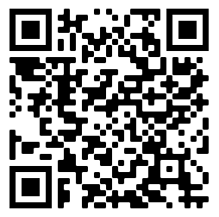
linkedin.com/
company/
external-reporting-board
Follow
Discover
Discover
https://www.xrb.govt.nz/assurance-standards/standards-in-development/open-for-comment/iaasb-lce/
Connect
enquiries@xrb.govt.nz

Slide 19
Disclaimer
This presentation provides personal views of the presenter and does not necessarily represent the views of the XRB or other XRB staff. Its contents are for general information only and do not constitute professional advice.
The XRB expressly disclaims all liability for any loss or damages arising from reliance upon any information in this presentation.
The contents of this presentation is not to be reproduced, distributed or referred to in a public document without the express prior approval of XRB staff.

